Slide 1
CodeQL – Azure User Group
March 2023 - How Open Source can protect you from yourself?

Slide 2


Question what is the difference in Static and Dynamic testing?
Static testing
Examine the source code and the flow for information, compiled artifacts, etc. a.k.a. White/Gray box testing.
CodeQL
SonarQube
Snyk Code
Qodana
Dynamic testing
Carried out on software during
code execution a.k.a. Black box testing.
Burp suite
Crowdstrike
OWASP ZAP
Intruder
Keep in mind when reviewing tools.
Common Weakness Enumeration (CWE) is the cause
Common Vulnerability Enumeration (CVE) is the effect

Slide 3
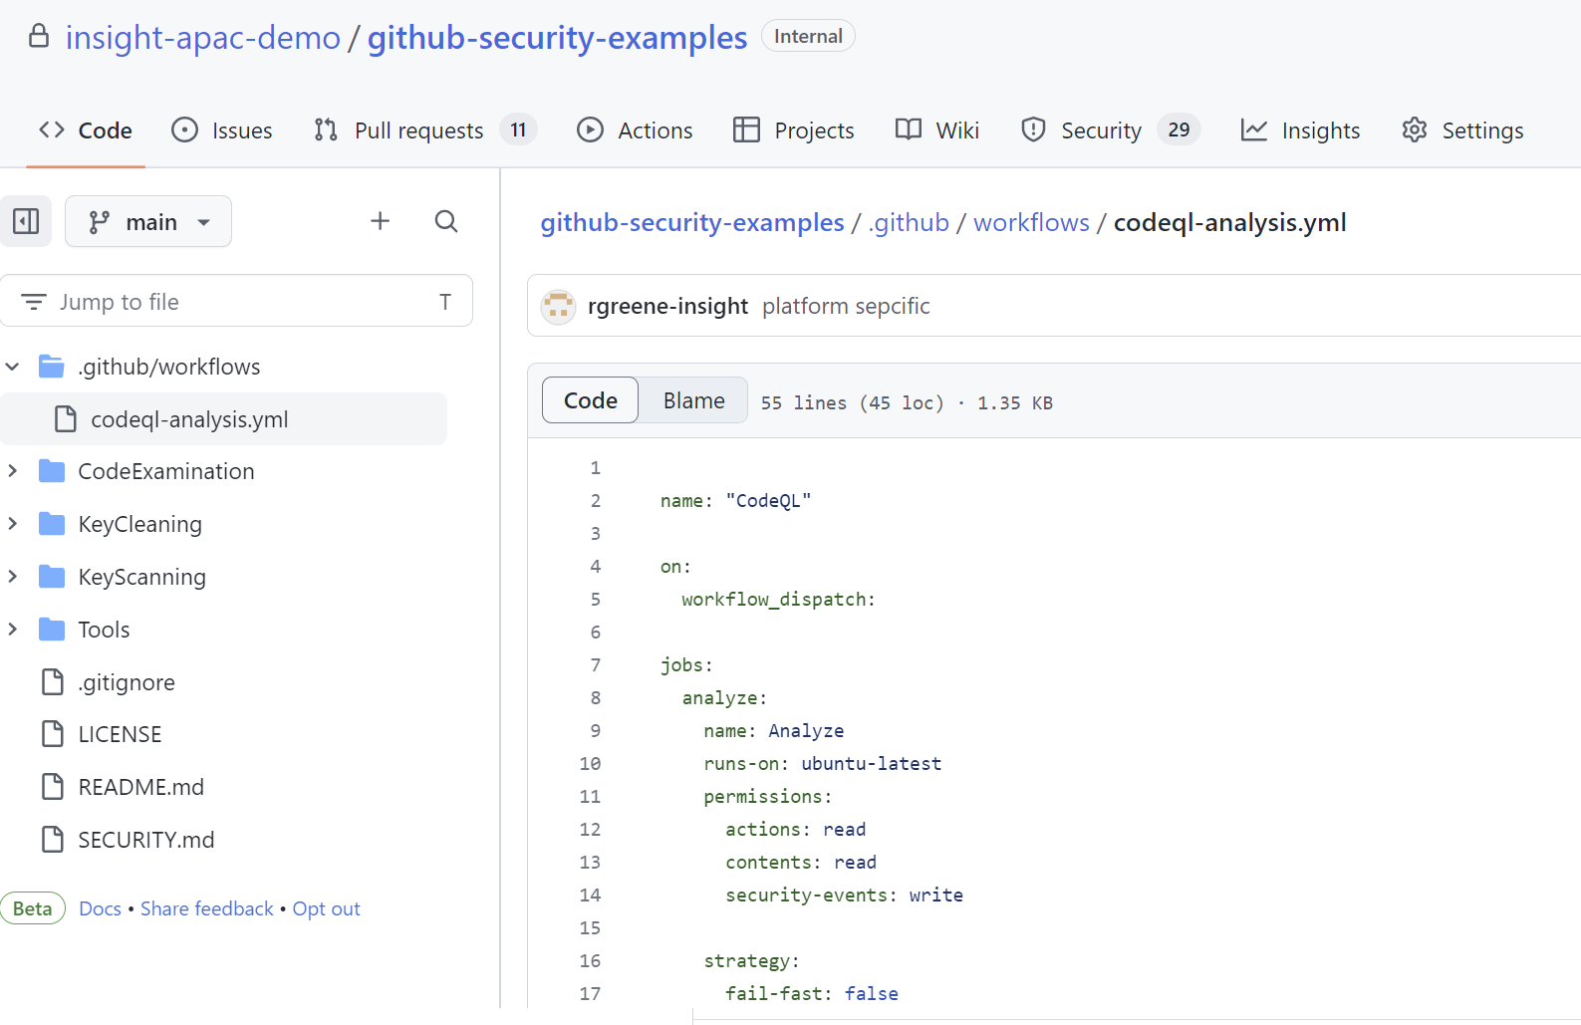
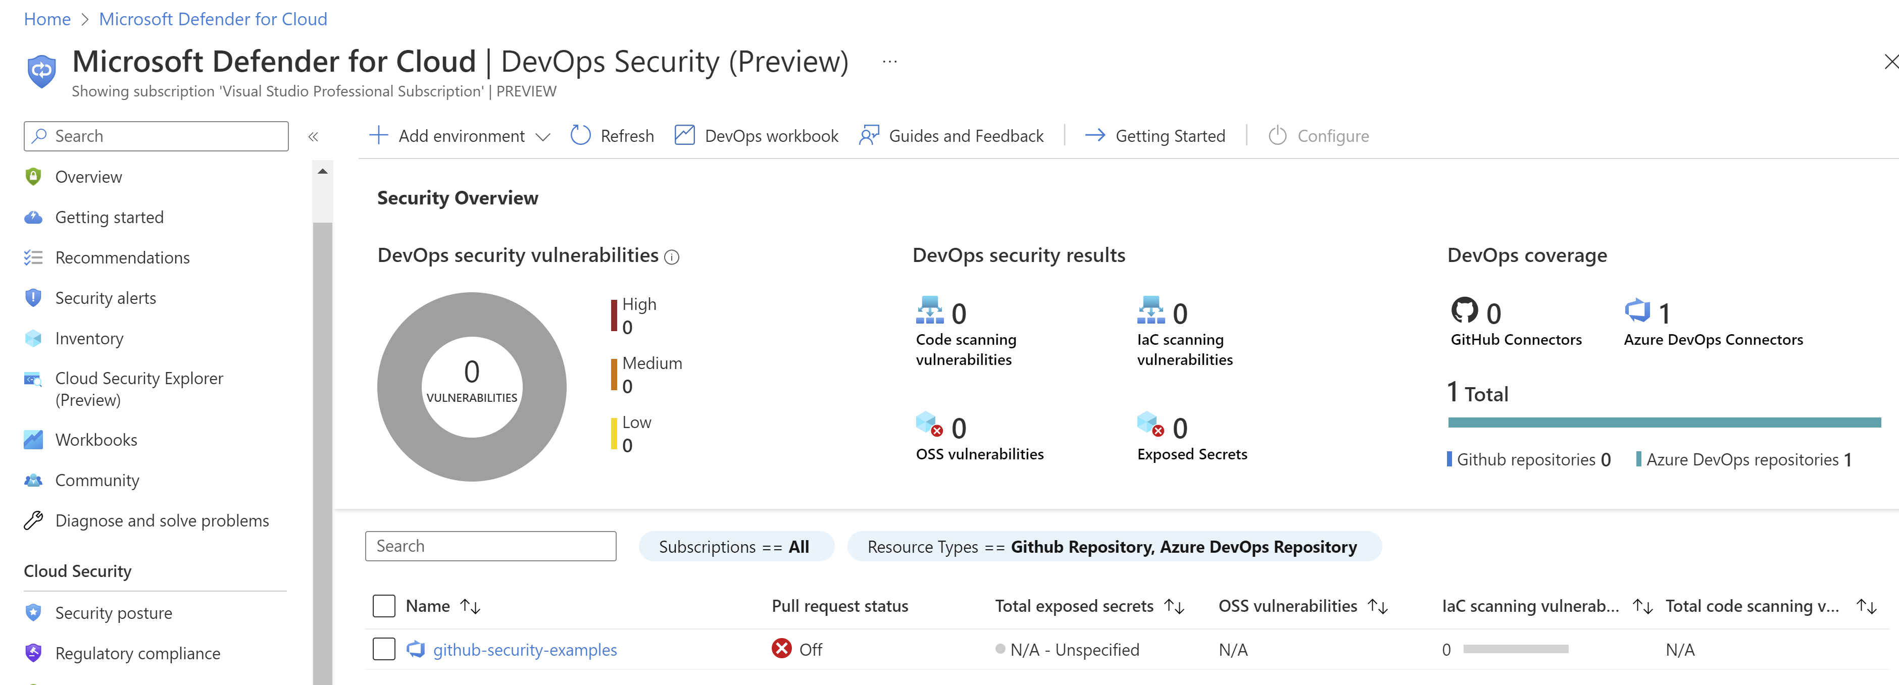
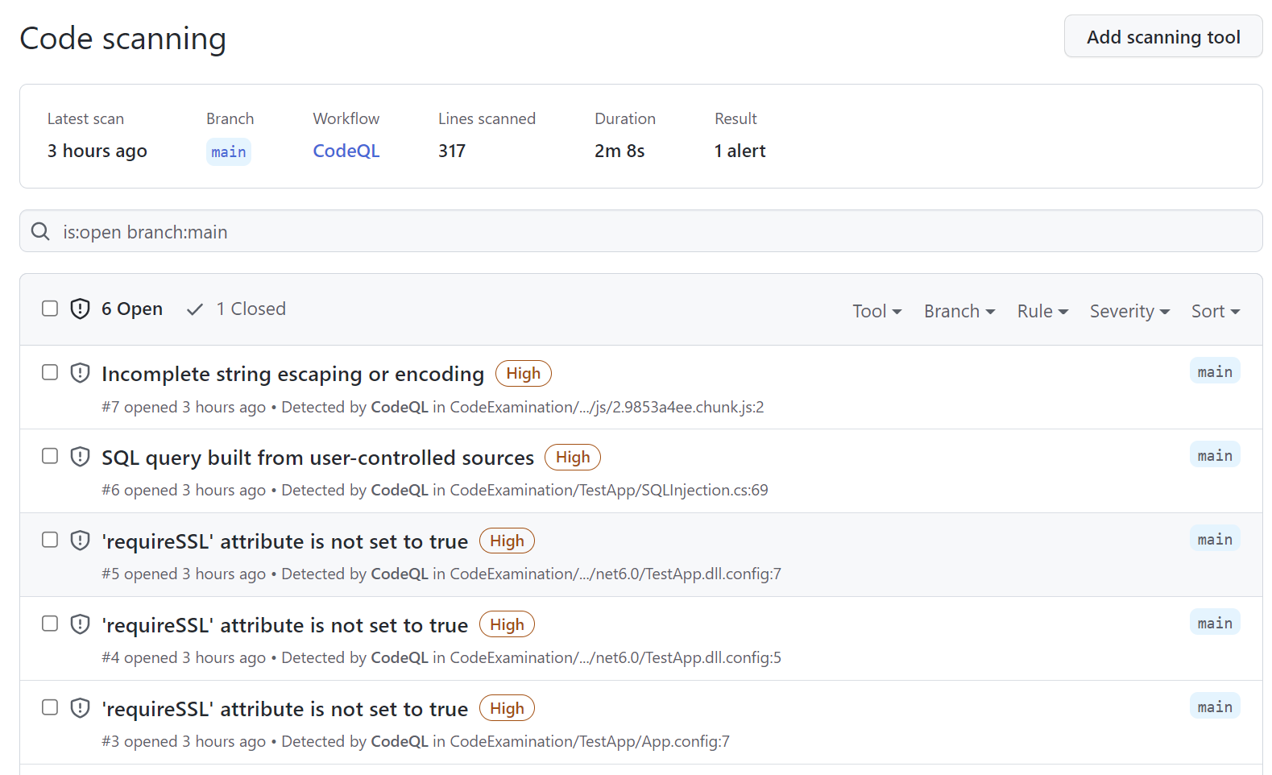

Where can you get CodeQL and how does it help?
Open-Source(‘ish) tool for code analysis
Available in GitHub Public Repos, also under license as “Advanced Security” for private/internal repositories
Can be used for academic research and demos

Slide 4
CodeQL Analysis Process
Pack
Supports several languages
C/C++, C#, Go, Java
Python, Ruby, JavaScript, Typescript*
QL Compiler
* Typescript is really, just compiled JavaScript
Query
Code
Extractor
Columnar Database
Evaluator
GitHub Action is easier
# Analysis and publish results
- name: Perform CodeQL Analysis
uses: github/codeql-action/analyze@v2
CSV
SARIF
Graphtext
Static Analysis Results Interchange Format

Slide 5

But it does so much more..
Demo
Setup
Local execution
Accessing existing packs
VS Code integration and custom queries
Bounty program for new submissions
Open-Source Community of developers
@GHSecurityLab on Twitter or Slack
A few capture the flag tests
Events schedule

Slide 6
Final words on providing submissions
Submit your pull requests in the experimental folder, following the published guidelines.
Create an issues noting what vulnerability groups you are targeting (CWE)
Evaluation with take time based on
Performance
Impact
Number of false positives, over several large codebases
Eventually your submission will be migrated into the full pack (maybe)

Slide 7
Questions?
All code available on GitHub :
https://github.com/RGreene-Insight-Organisation/github-security-examples
“Coding makes finding bugs again !?”

